Slide 1
Test Report Summary Presentation
Chester Gardner

Slide 2
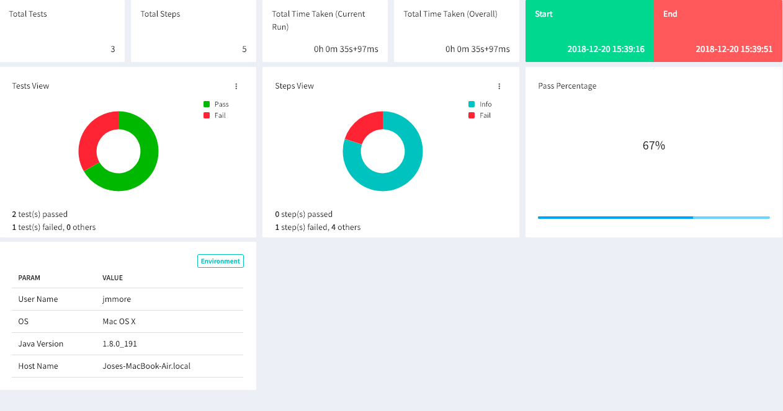
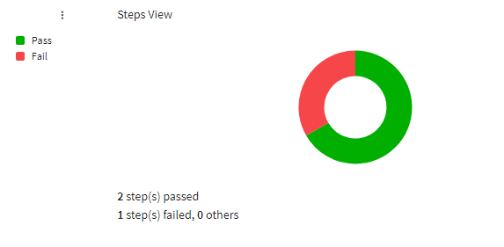
Functional – Selenium testing

Slide 3
Functional – REST testing
The tests that were executed all succeeded as expected.
There are still tests pending, and results will be presented in the next test cycle reports.

Slide 4
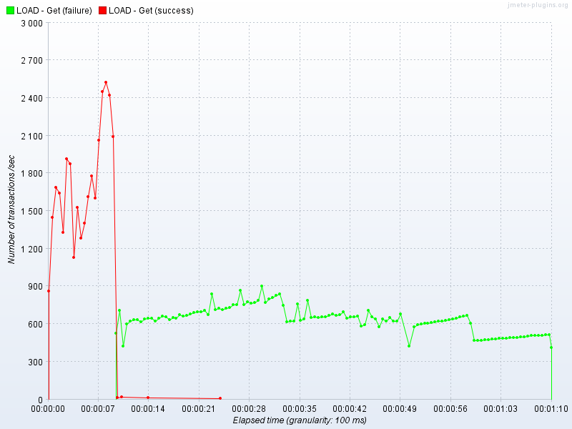
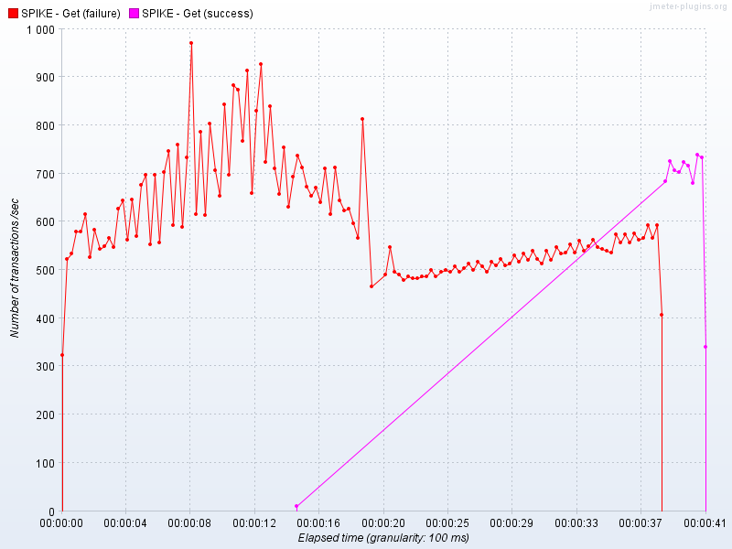
Non-functional – JMeter testing

Slide 5
Found defects
A number of defects were found whilst conducting non functional testing. This has shown that the system under test was not fit for purpose and that a go live decision cannot be recommended.

